Slide 1

Android App Development Session 10

Slide 2
Contents
Firebase Realtime Database

Slide 3
Firebase Realtime Database
Store and sync data with our NoSQL cloud database. Data is synced across all clients in realtime, and remains available when your app goes offline.
The Firebase Realtime Database is a cloud-hosted database. Data is stored as JSON and synchronized in realtime to every connected client.
When you build cross-platform apps with our iOS, Android, and JavaScript SDKs, all of your clients share one Realtime Database instance and automatically receive updates with the newest data.

Slide 4
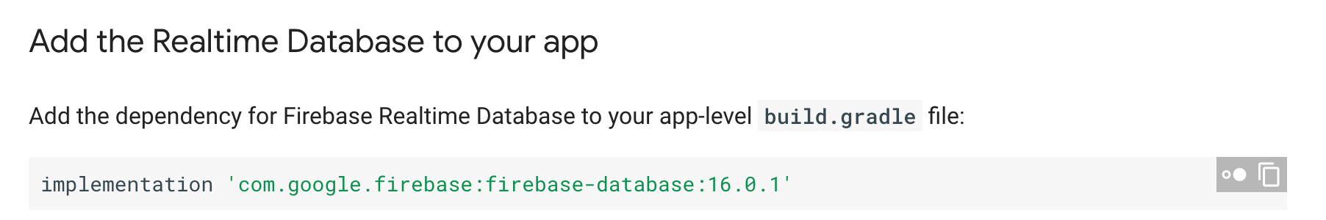
Set up

Slide 5
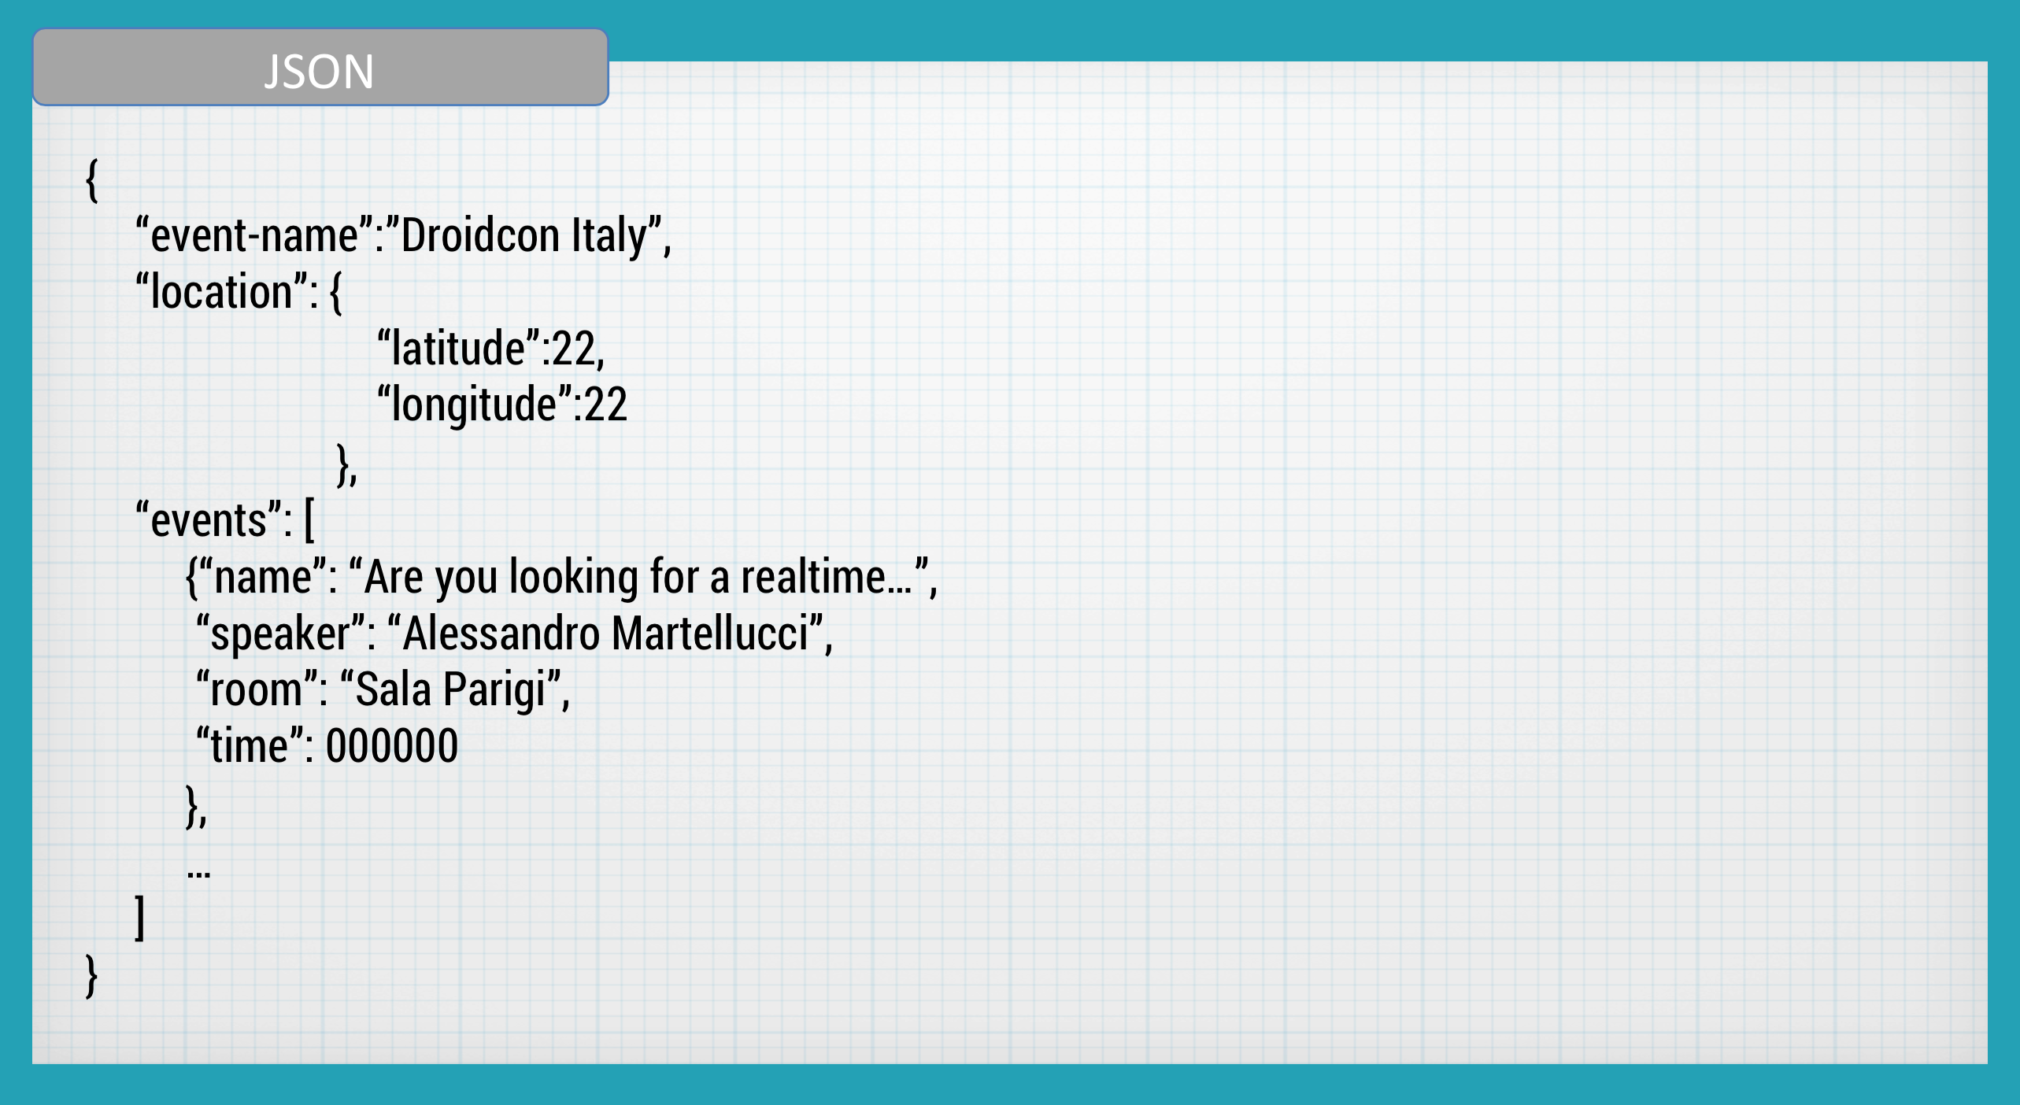
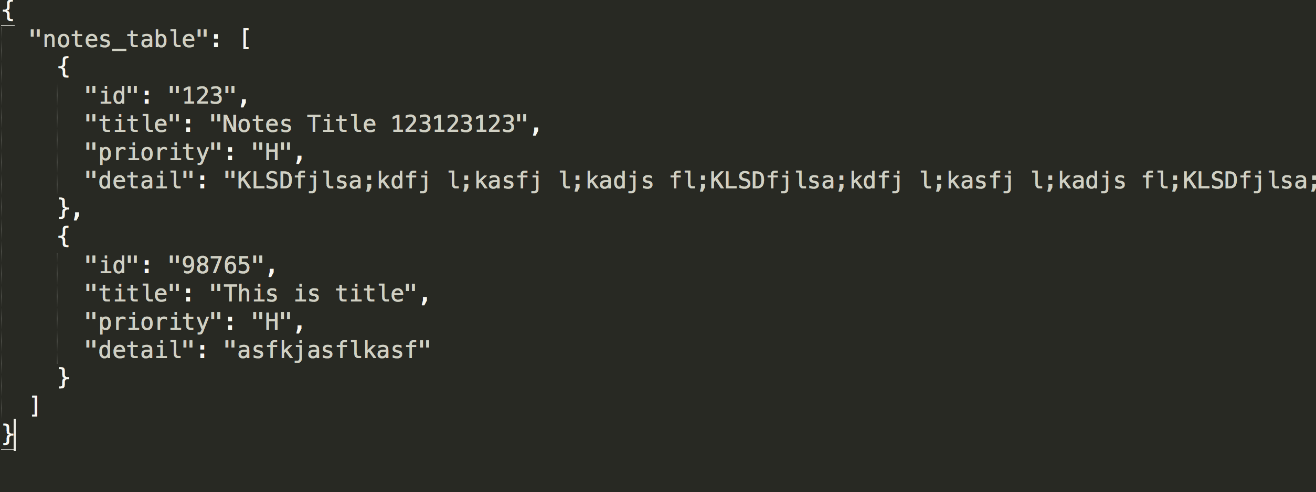
Database Structure

Slide 6
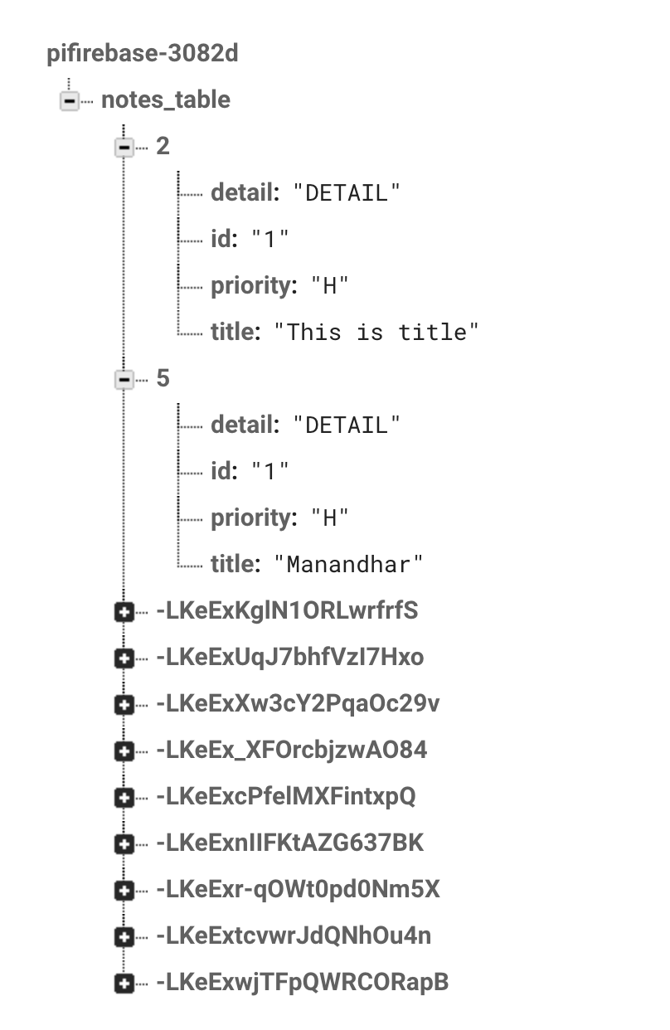
Database Structure in Firebase Console

Slide 7
CRUD Operation
CREATE procedures:
Performs the INSERT statement to create a new record.
READ procedures:
Reads the table records based on the primary keynoted within the input parameter.
UPDATE procedures:
Executes an UPDATE statement on the table based on the specified primary key for a record within the WHERE clause of the statement.
DELETE procedures:
Deletes a specified row in the WHERE clause.

Slide 8
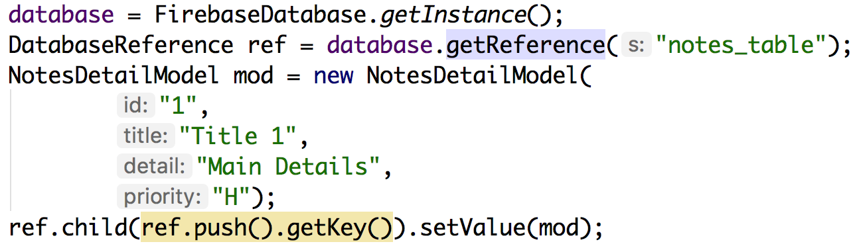
Insert

Slide 9
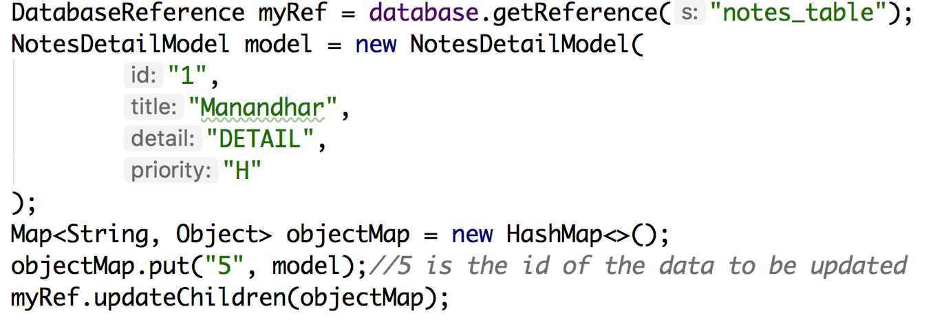
Update

Slide 10
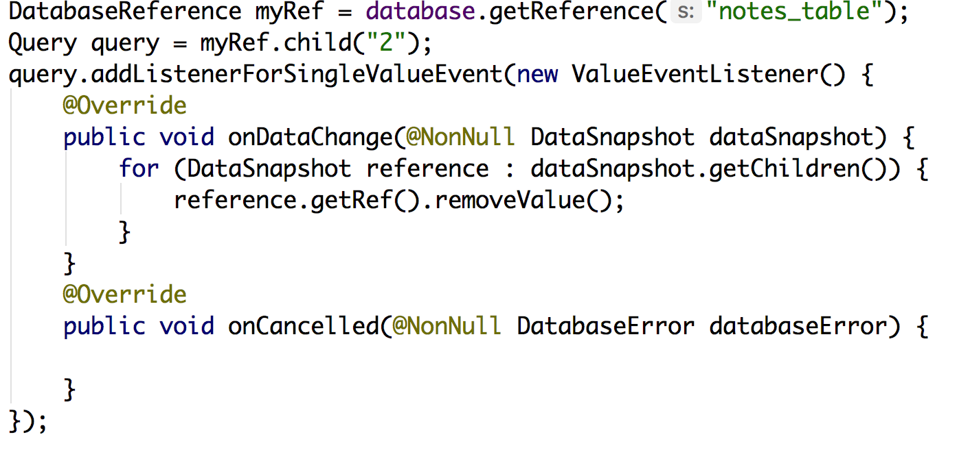
Delete

Slide 11
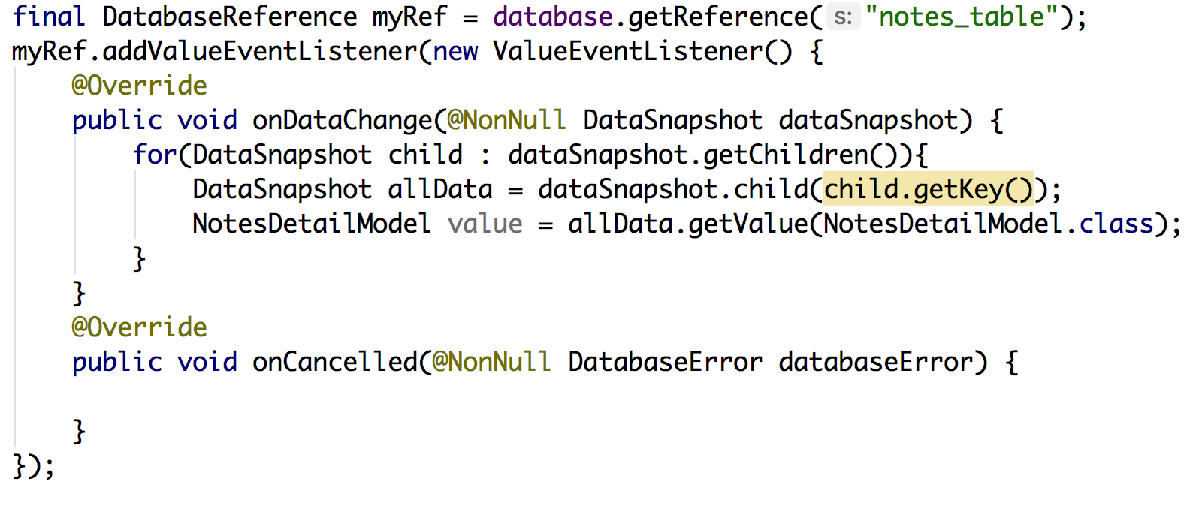
Read

Slide 12
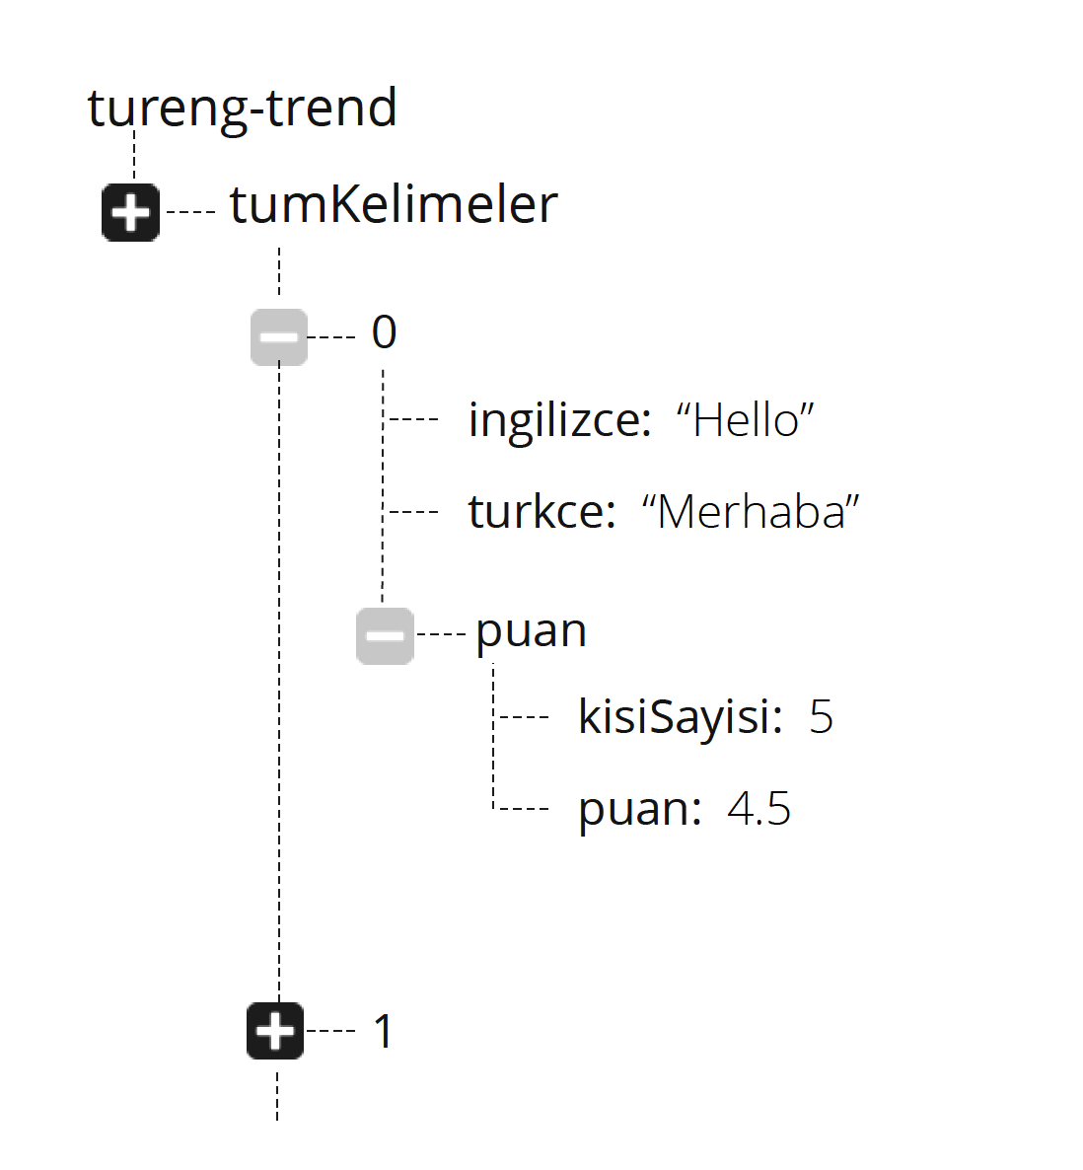
Further More

Slide 13
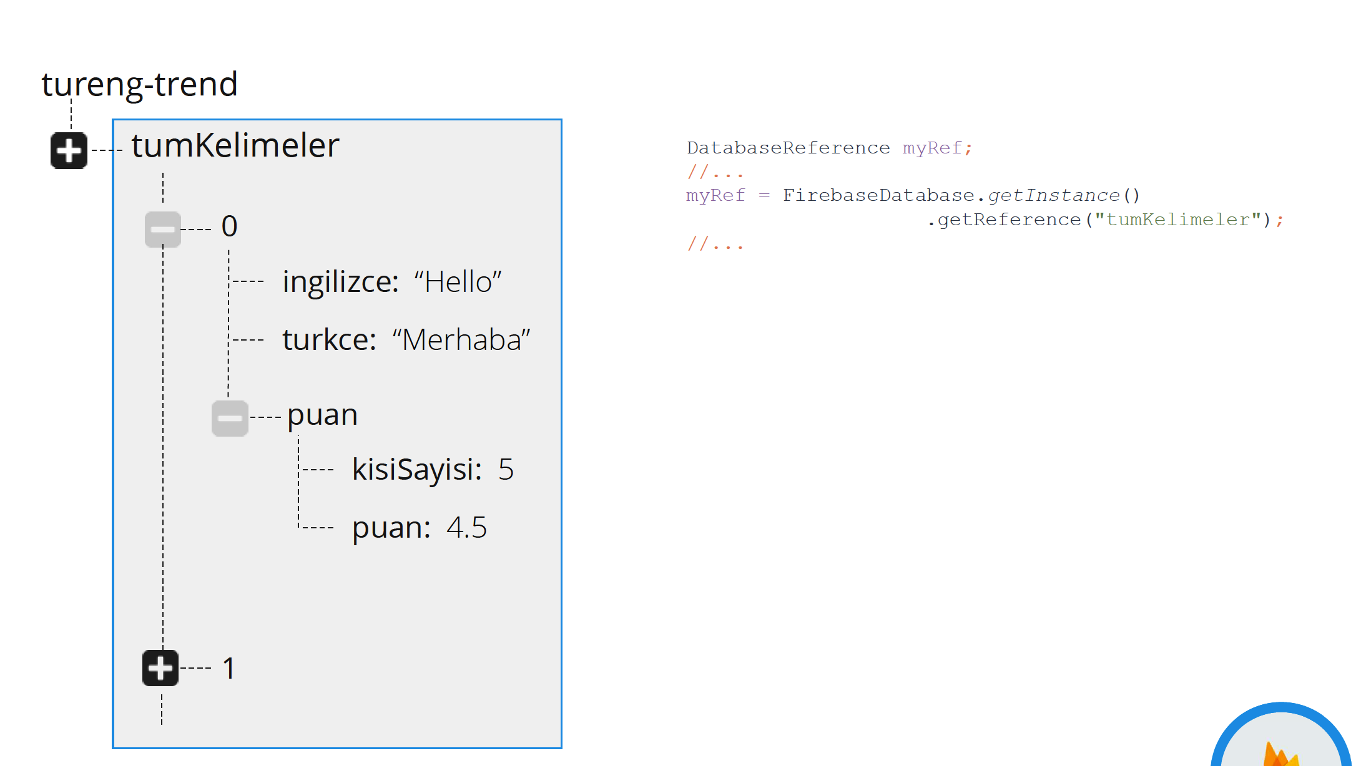
Further More

Slide 14
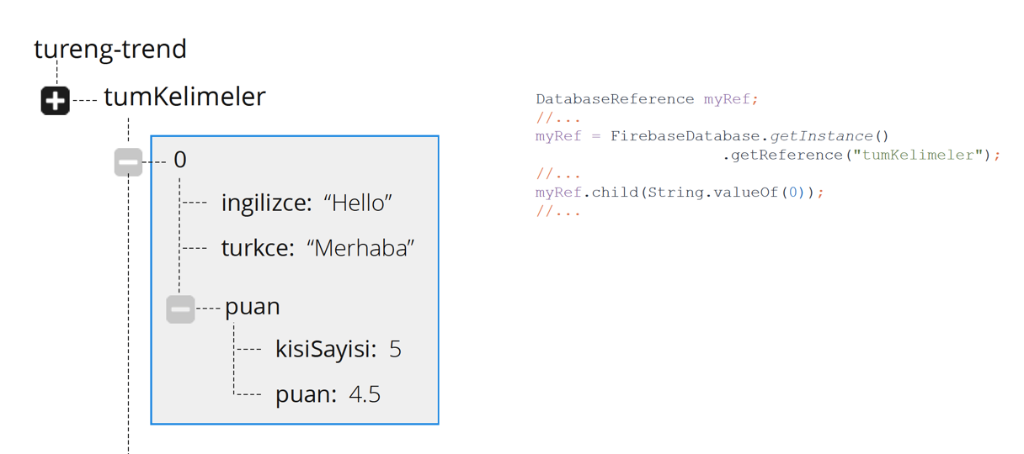
Further More

Slide 15
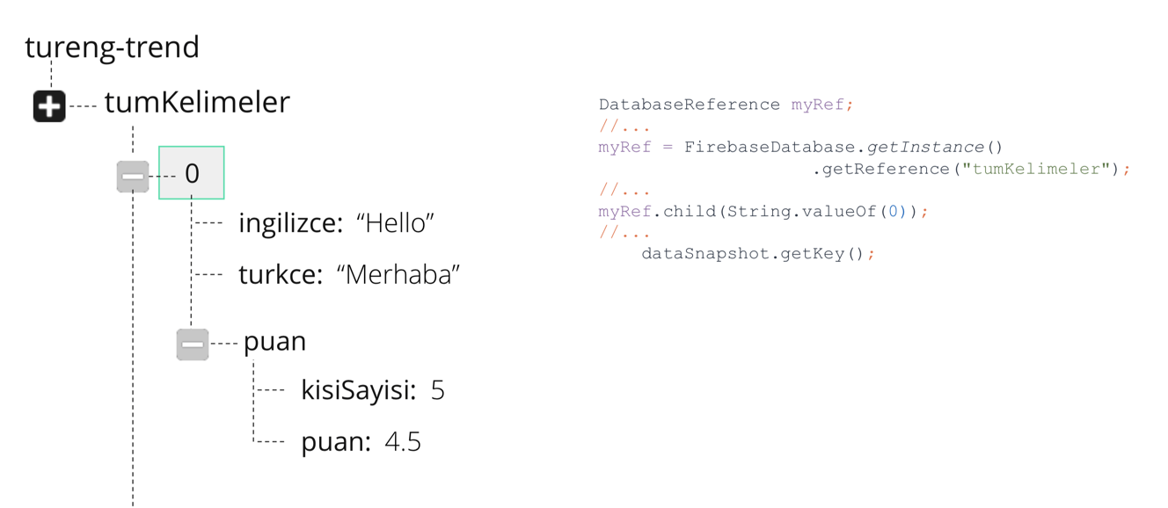
Further More

Slide 16
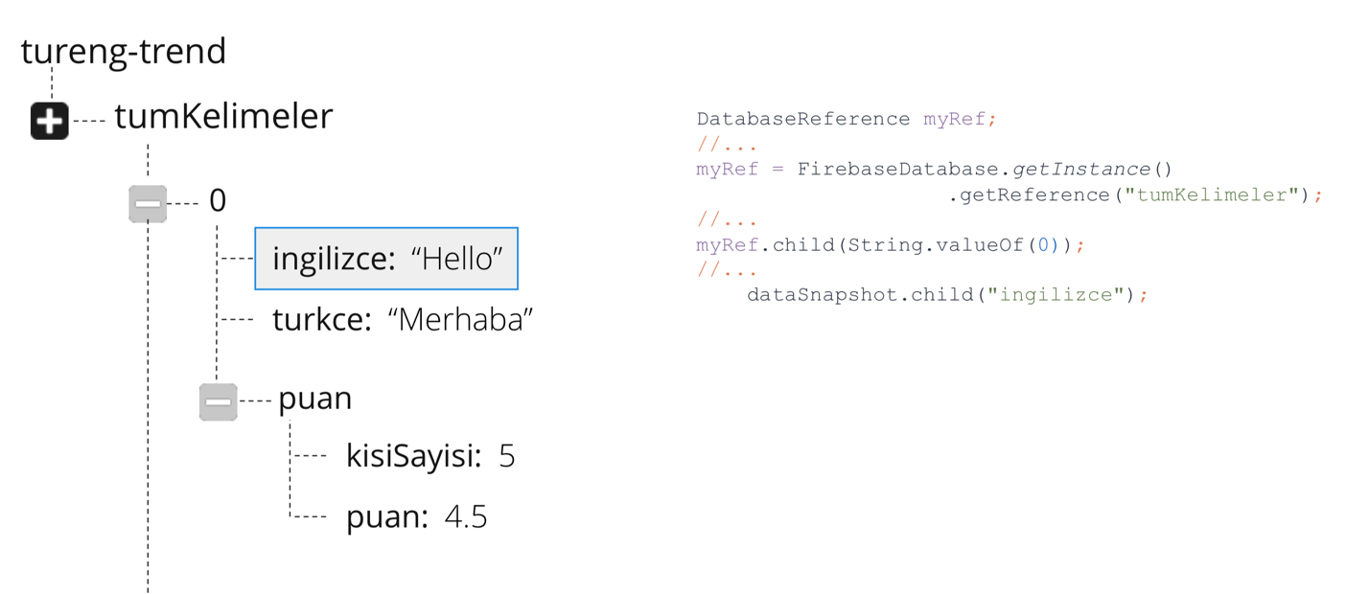
Further More

Slide 17
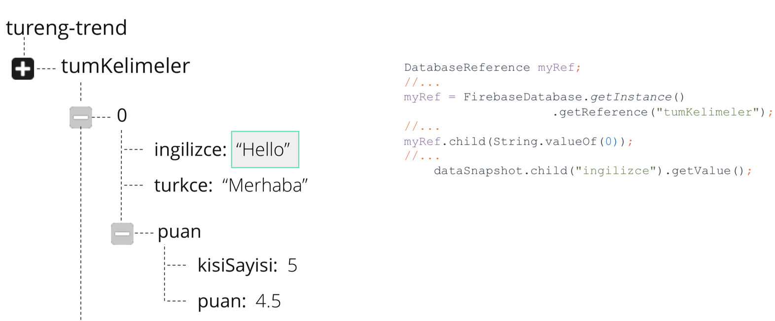
Further More

Slide 18
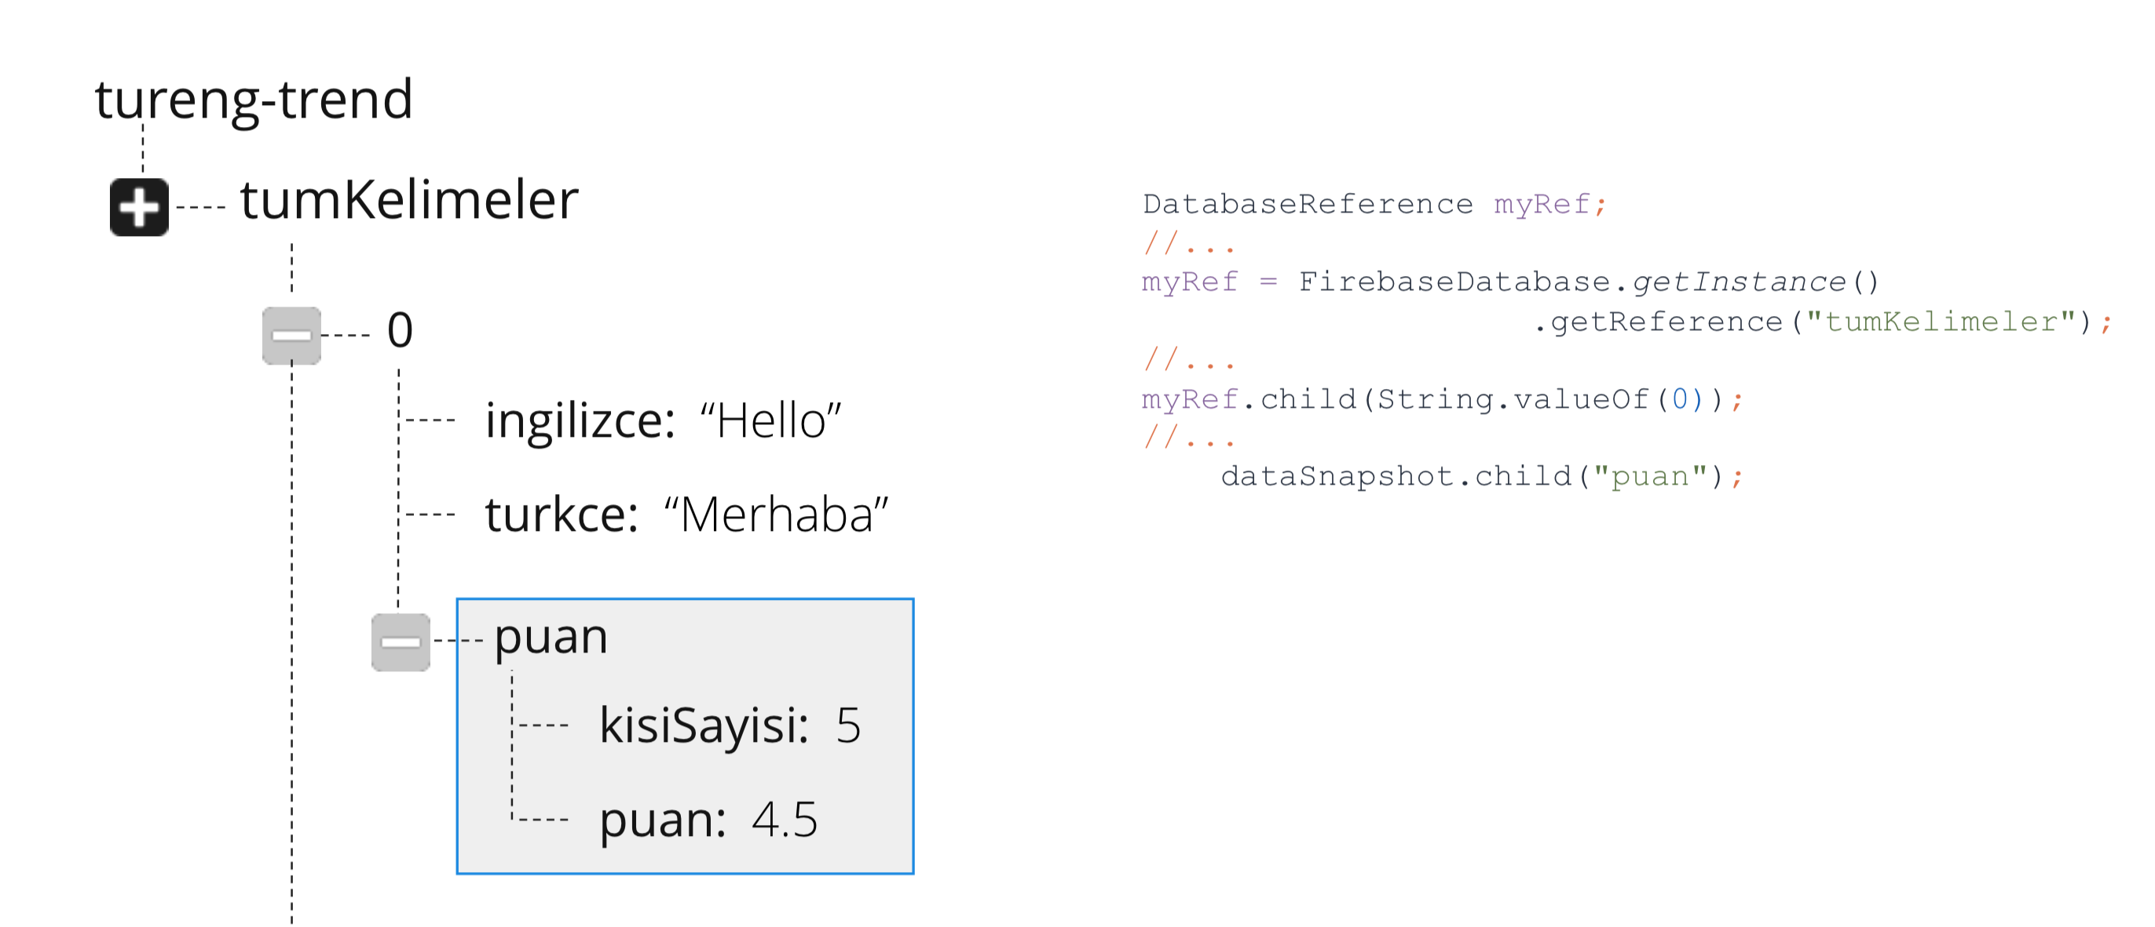
Further More

Slide 19
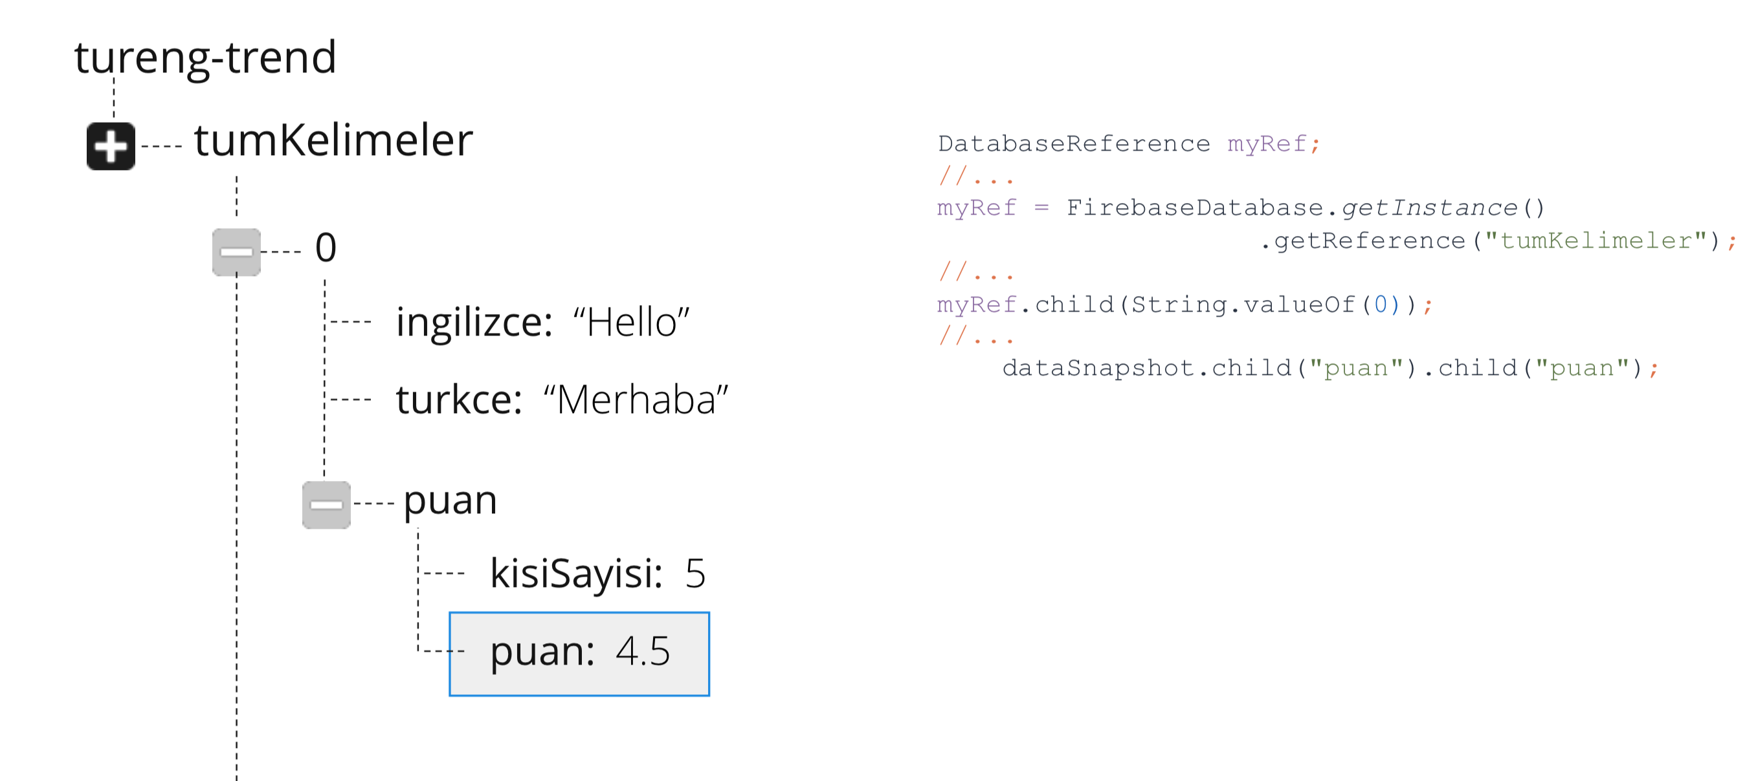
Further More

Slide 20
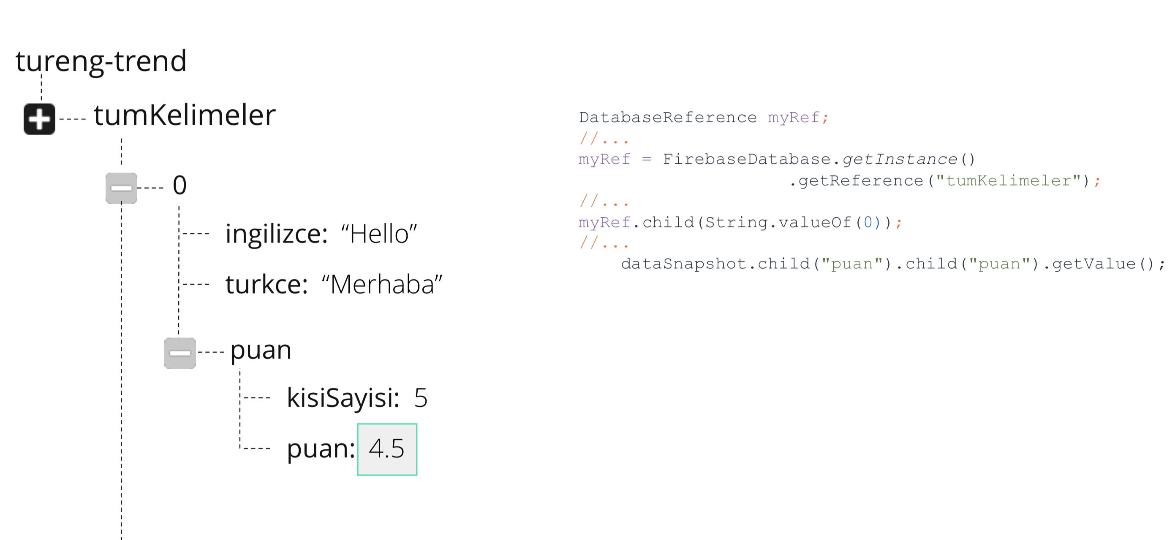
Further More

Slide 21
Thanks!
Any questions?
You can find me at bibesh.manandhar@gmail.com

